Slide 1
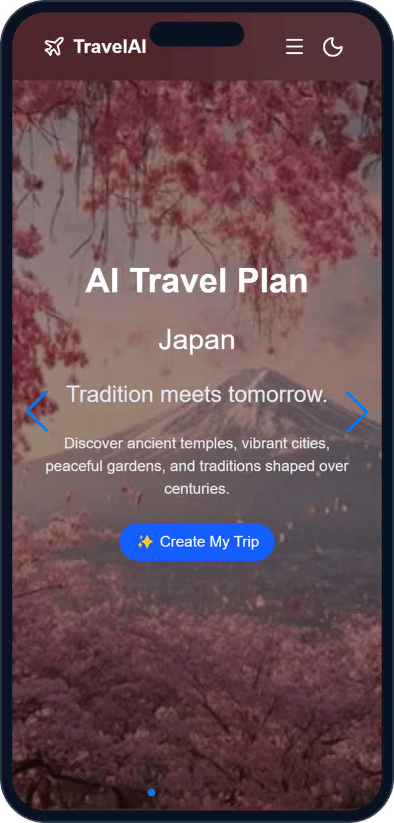
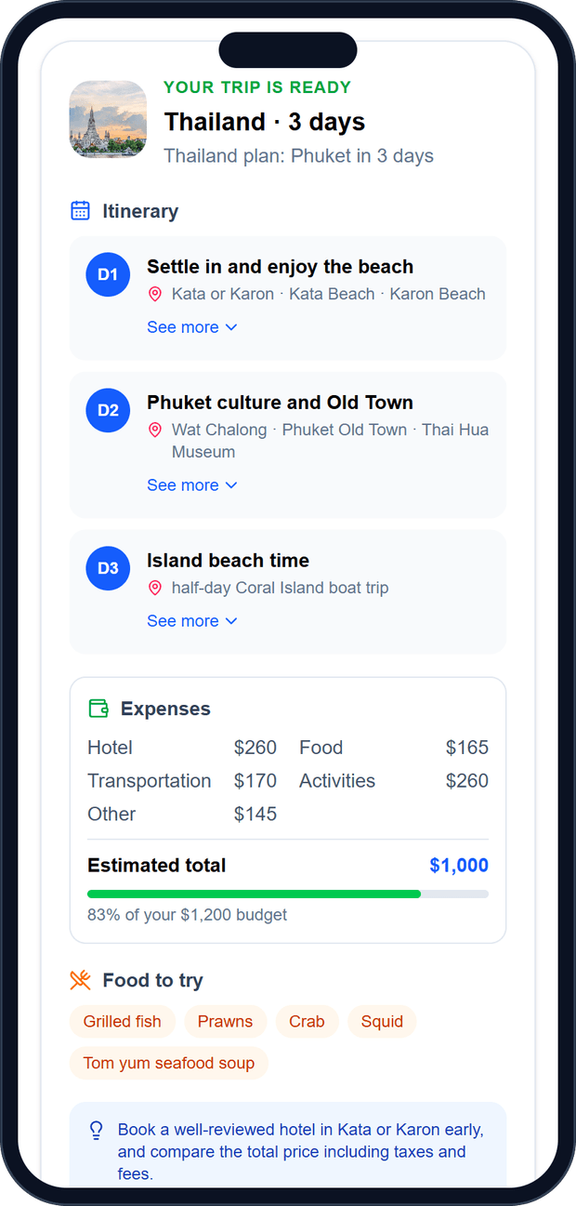
WEB PROGRAMMING · GACHON UNIVERSITY
TravelAI
An AI travel planner that turns a few simple choices into a ready-to-use itinerary
Mukhammadamin
Abdulazizbek
Asadbek
Back-end developer
Front-end developer
Designer
ID 202537558
ID 202537225
ID 202537228
Notes:
Introduce TravelAI: an AI travel planner built for the Web Programming course at Gachon University. Introduce the three team members and their roles.

Slide 2



The team behind TravelAI
Mukhammadamin
Abdulazizbek
Asadbek
Back-end developer
Front-end developer
Designer
Student ID 202537558
Student ID 202537225
Student ID 202537228
REST API for sign up, log in and trip plans
PostgreSQL database for user accounts
OpenAI GPT integration, hosted on Render
React + Vite app with Tailwind CSS
Routing, protected pages and the planner
Trip card, saving, and GitHub Pages deploy
Visual identity, colors and typography
Page layouts and the user journey
Responsive designs for phone and tablet
Notes:
Each member owned one area: back end, front end, and design. We worked together on the user flow and testing.

Slide 3



Planning a trip still takes too long
Too many tabs
Flights, hotels, blogs and maps all live in different places.
OUR QUESTION
What if one short form could give you a complete, personal trip plan in under a minute?
Unclear budget
It is hard to know what a trip will really cost before you go.
Generic advice
Most guides ignore your interests, food tastes and travel style.
That question became TravelAI.
Notes:
Explain the problem from a traveller’s point of view: scattered information, unclear costs, and advice that is not personal.

Slide 4



TravelAI: plan smarter, travel better
Pick a destination, days, budget and interests. TravelAI does the rest.
AI itinerary
Smart budget
A day-by-day plan with places to visit, written by OpenAI GPT.
Cost breakdown and a total compared with your own budget.
Personal choices
Save and favorite
Interests, travel style and food likes shape every plan.
Keep plans in My Trips and Favorites to open later.
Notes:
Our solution in one sentence: a short form in, a clear personal plan out. Four main features.

Slide 5





How the system fits together
PostgreSQL
User accounts
User
React front end
REST API
Phone, tablet or laptop browser
Vite + Tailwind CSS, hosted on GitHub Pages
Hosted on Render: /api/auth, /api/travel
OpenAI GPT
Writes the itinerary text
TECH STACK
React 19
Vite
Tailwind CSS
React Router
Framer Motion
PostgreSQL
OpenAI GPT
GitHub Actions
GitHub Pages
Render
Notes:
The browser loads the React app from GitHub Pages. The app calls our REST API on Render. The API stores users in PostgreSQL and asks OpenAI GPT to write the itinerary.

Slide 6





From sign-up to itinerary in six steps
01
02
03
04
05
06
Sign up
Log in
Dashboard
Plan
Itinerary
Save
Create an account with username, email and password.
A secure token keeps you signed in on this device.
Your home base: start a plan or open saved trips.
Five quick steps: place, days, budget, interests, style.
GPT writes the plan; TravelAI turns it into a clear card.
Keep it in My Trips or Favorites for later.
Every step works on phones, tablets and desktops. The next slides follow this path on a phone screen.
Notes:
Walk through the whole journey before showing each screen.

Slide 7
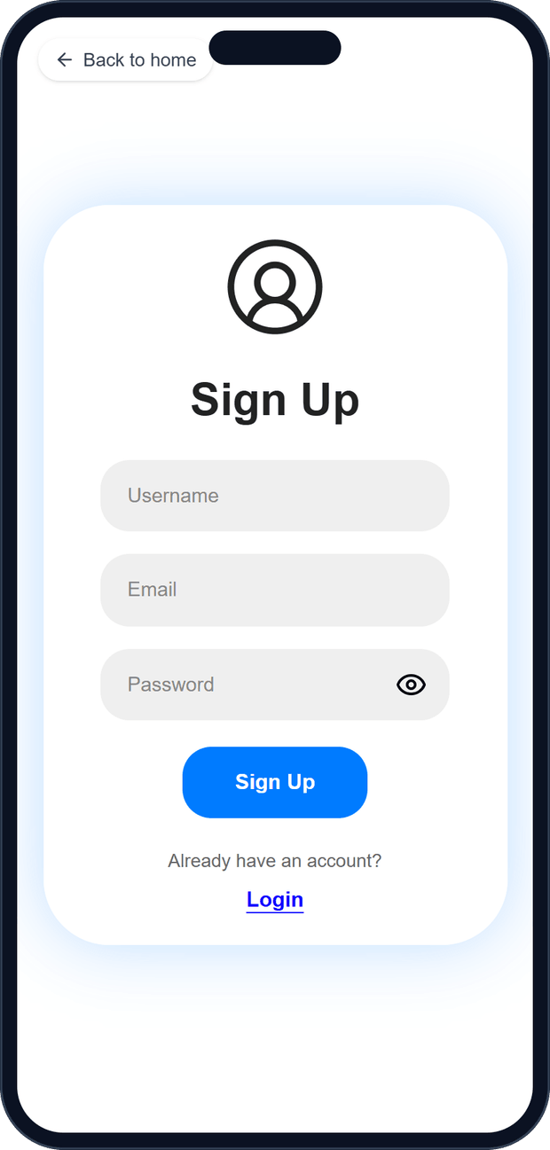
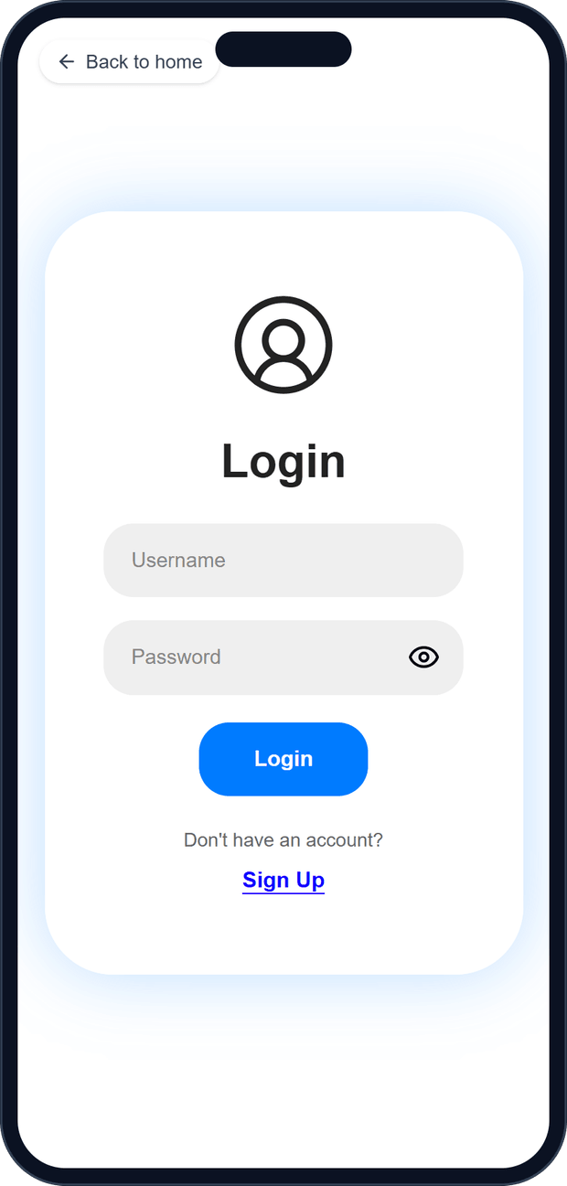


Sign up and log in
Create an account
Username, email and password go to /api/auth/register and are saved in PostgreSQL.
Log in once
The API returns a token. The app keeps it in the browser and checks it with /api/auth/profile on every visit.
Protected pages
Dashboard, Planner, My Trips and Favorites send visitors without a valid token to Login.
Notes:
Sign up and log in share one screen that switches between the two forms. After login the token is stored, so users stay signed in.

Slide 8
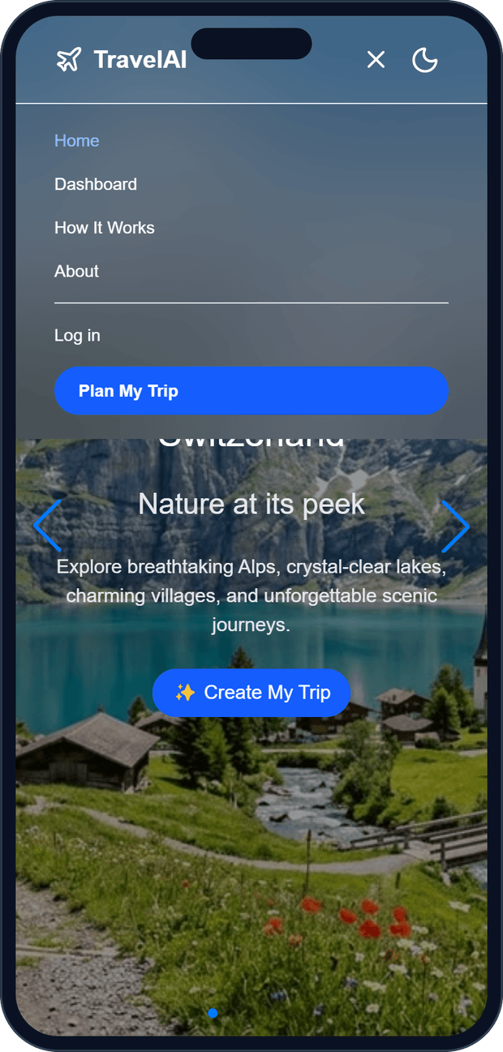
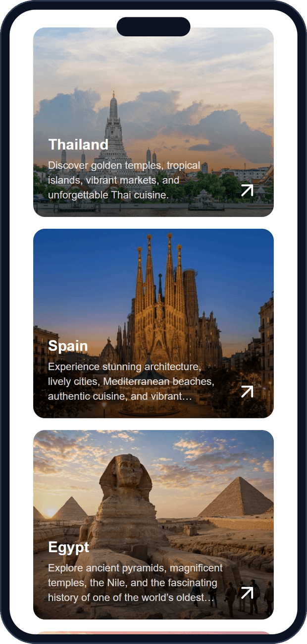



A landing page that invites you in
Hero carousel
Featured countries with a tagline and a Create My Trip button.
Clear navigation
Home, Dashboard, How It Works and About fold into a menu on phones.
Popular places
Destination cards lead straight into the planner.
Notes:
The home page is the first impression: a full-screen carousel, simple navigation, popular destinations, and a light/dark theme switch.

Slide 9
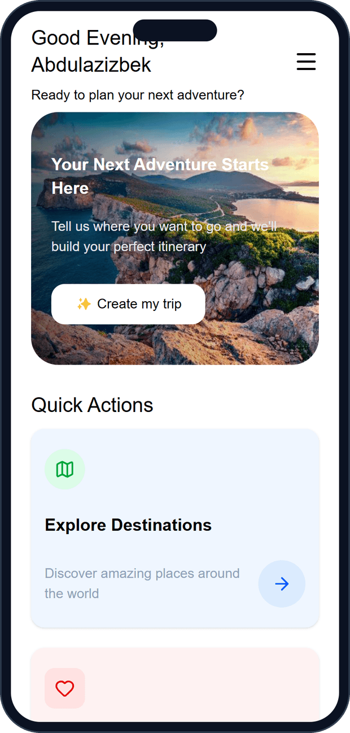
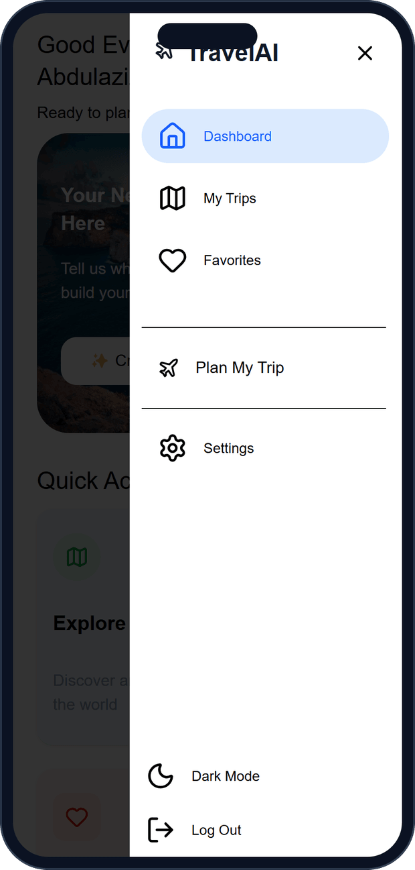
Dashboard: the home base
01
Personal greeting
Users are greeted by name with a banner that starts a new trip.
02
Quick actions
Shortcuts to explore destinations, My Trips and Favorites.
03
Slide-out menu
On phones, the sidebar becomes a drawer with dark mode and a safe log-out confirmation.
Notes:
After login, the dashboard is where every session starts.

Slide 10
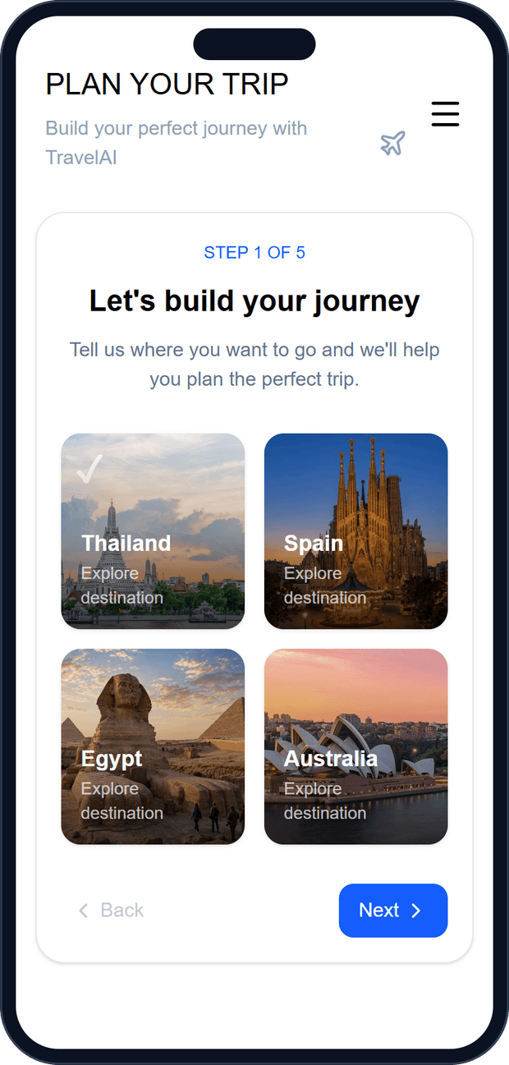
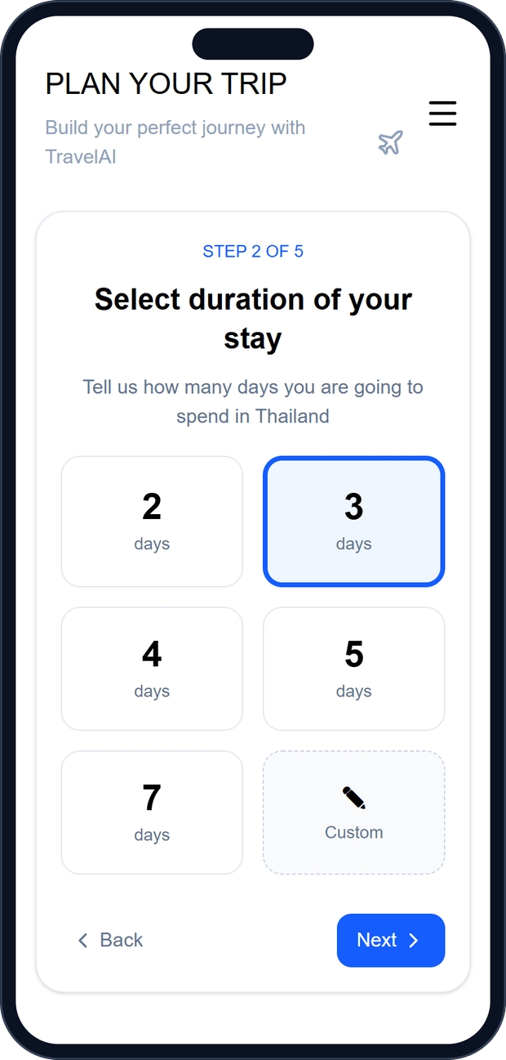
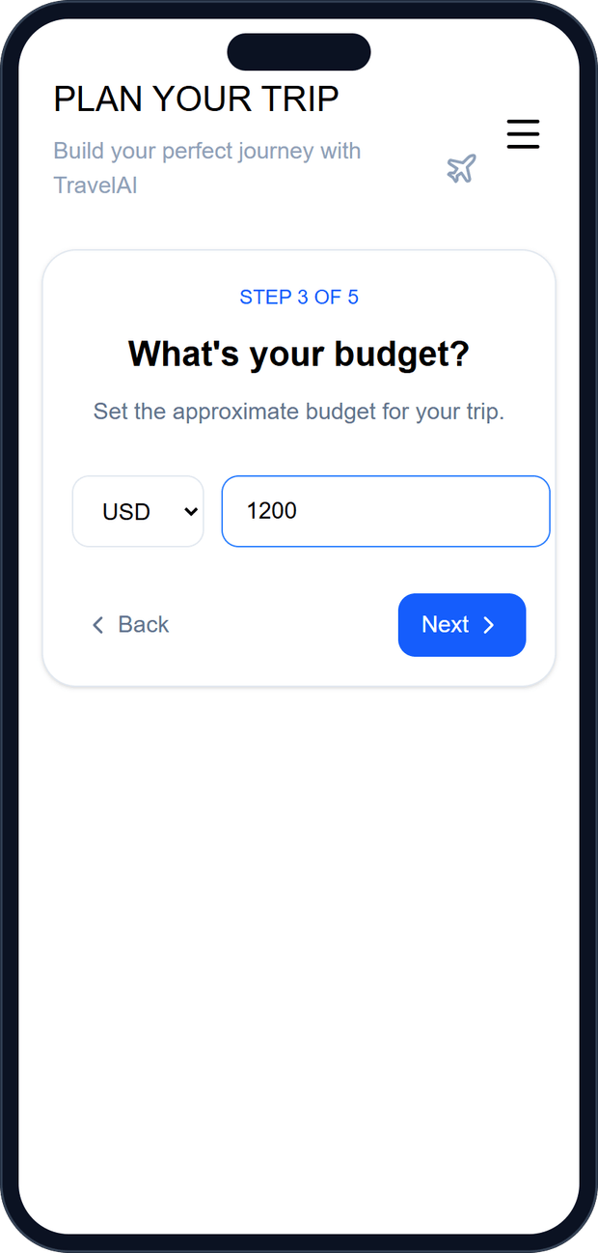
Planner steps 1–3: where, how long, how much
1
2
3
Pick a destination
Choose the days
Set the budget
Required before you can continue.
2 to 7 days, or a custom 1–30.
USD, KRW, EUR or GBP.
Each step checks its answer before moving on, so the AI always gets complete information.
Notes:
Steps 1 to 3 collect the essentials: destination, length of stay and budget.

Slide 11
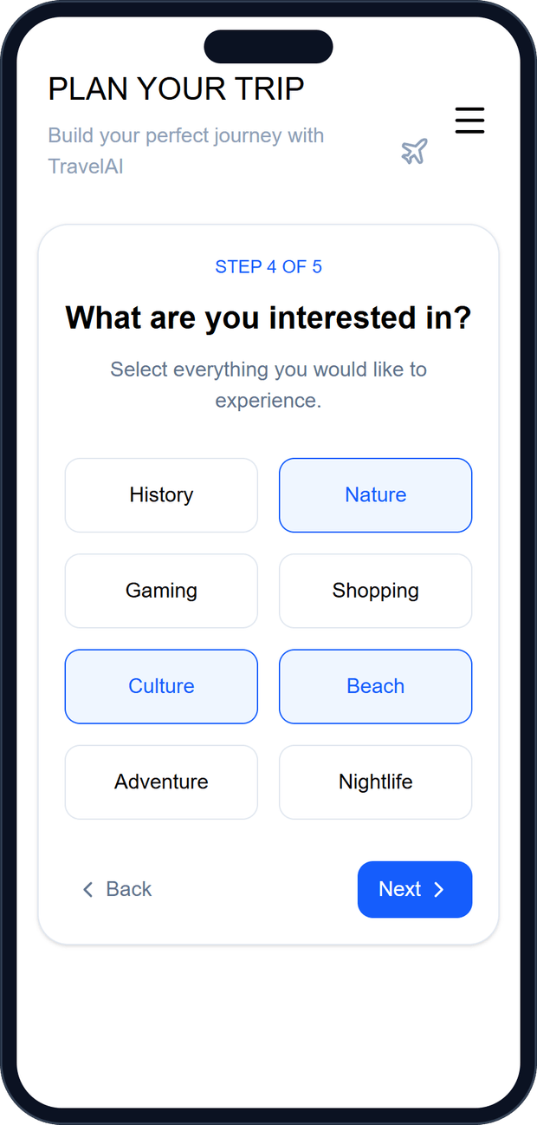
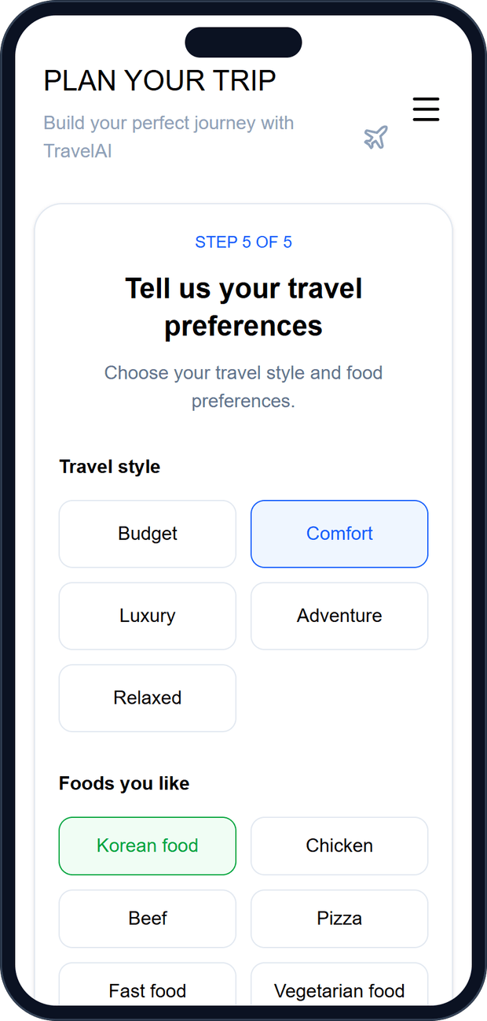
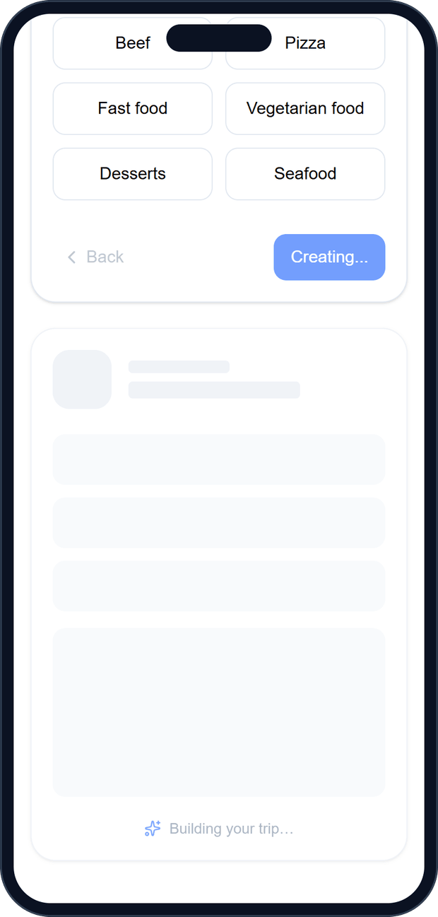


Steps 4–5: interests, style and food
Pick what you love
History, nature, beach, nightlife and more — choose as many as you like.
Style and food
Budget to luxury, plus foods you like and want to avoid.
Generate
All choices go to /api/travel/plan. A loading card shows while GPT writes.
Notes:
The last two steps make the plan personal. Generate sends everything to the back end, which asks OpenAI GPT for an itinerary.

Slide 12


From a long AI essay to a clear trip card
Days and places
WHAT GPT RETURNS
Each day’s theme with up to three places.
## Thailand plan: Phuket in 3 days
### Day 2 — Phuket culture and
Old Town
- Visit **Wat Chalong**, one of
Phuket’s best-known temples…
- Explore **Phuket Old Town** for…
| Hotel — 2 nights | **$260** |
| Food | **$165** |
| **Estimated trip spending** | …
Expenses
Cost breakdown, total and share of your budget.
Food to try
Up to five dishes as tags.
One tip
A single money-saving tip.
…plus ~60 more lines of text
Notes:
GPT answers with a long Markdown essay. Our parser picks out only the useful parts and shows them in a compact card. If the format is unexpected, the card falls back to a short summary.

Slide 13
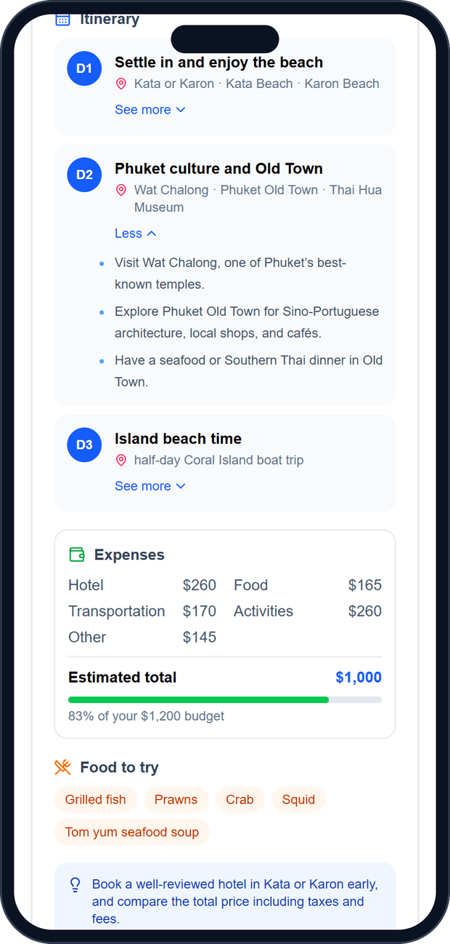
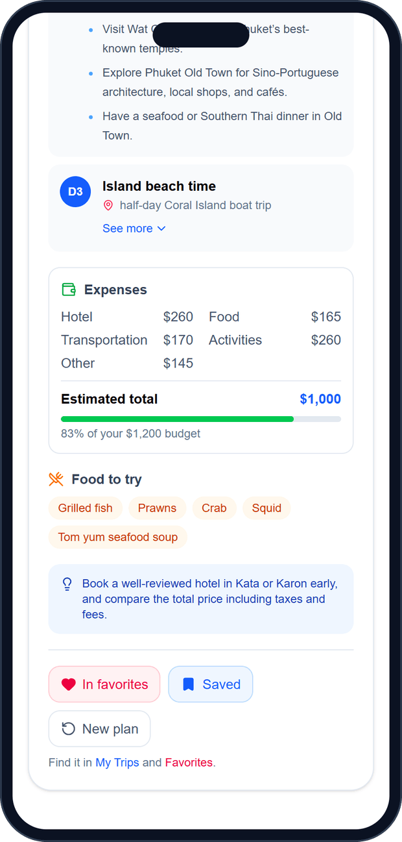
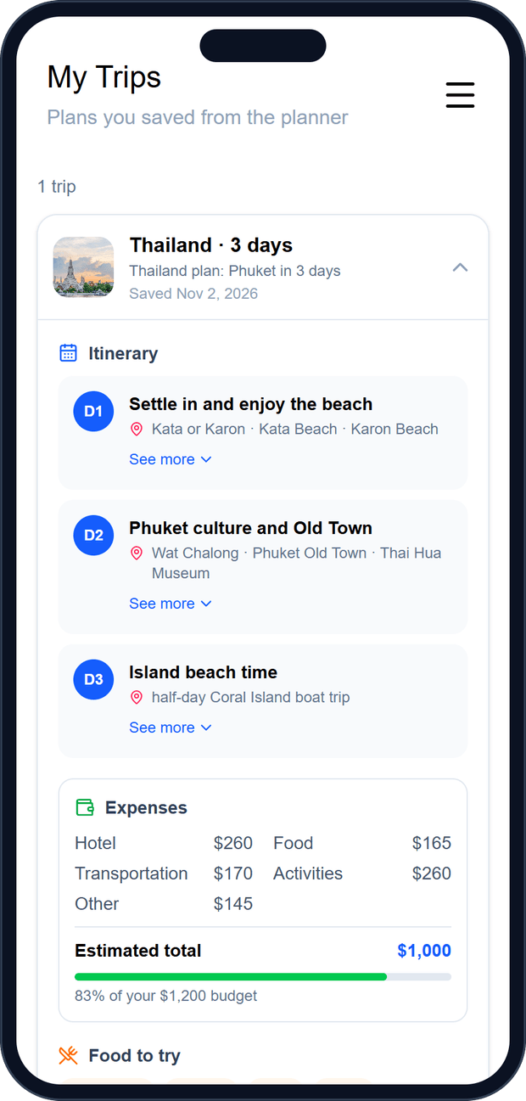


See more, favorites and My Trips
See more
Each day opens up to three short lines from the AI answer.
Favorite or save
One tap adds a plan to Favorites or My Trips; tap again to undo.
Open it later
Saved plans are listed by date and open into the full card.
Notes:
Users can read a little more about each day, then keep the plan. For now plans are stored in the browser per account; moving them to PostgreSQL is a next step.

Slide 14
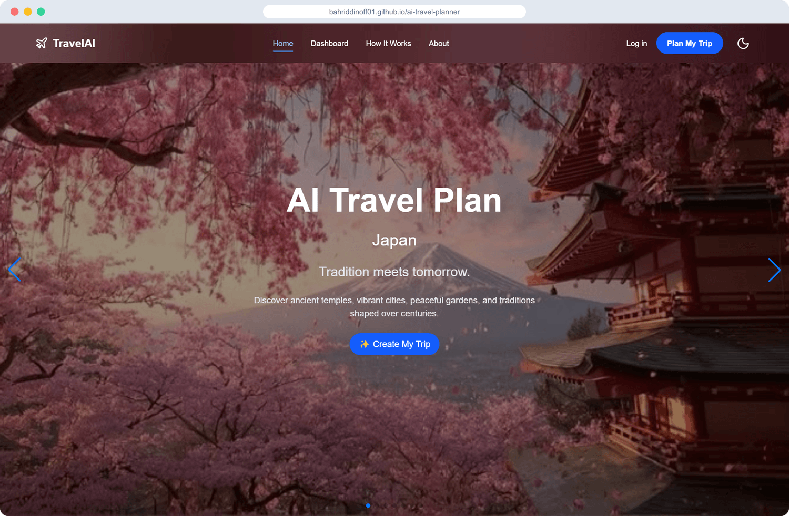
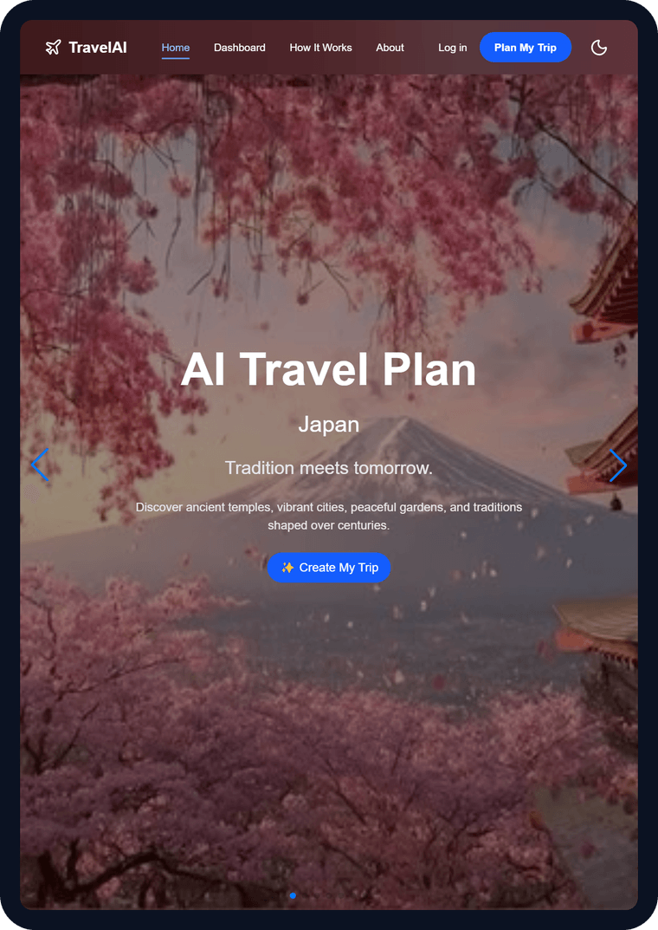
Responsive on every screen
Desktop · 1024px and up
Tablet · 768px
Phone · 375px
Full navbar, sidebar and three-column grids
Two-column cards
Stacked layout, slide-out menu
Notes:
We tested every page at phone, tablet and desktop sizes and removed all sideways scrolling.

Slide 15
What we learned and what comes next
CHALLENGES WE SOLVED
NEXT STEPS
GitHub Pages hosts the site under /ai-travel-planner/, so page refreshes broke until we set the base path and a 404 fallback.
GPT words its answer differently every time, so the parser accepts many heading and table styles.
Fixed widths broke phone layouts; we rebuilt them with responsive grids.
Store favorites and saved plans in PostgreSQL so they follow the user.
Show each day’s places on a map.
Share a plan with friends.
Add a Settings page and working dashboard shortcuts.
Thank you!
Try it live
bahriddinoff01.github.io/ai-travel-planner
Questions are welcome.
Notes:
Summarise the challenges and the planned improvements, then invite questions.

